Slide 1
NetWorks Presentation
Created by: Balázs József Borsos, Levente Zsolt Diósi

Slide 2
Introduction
Team Name: NetWorks
Company: Telekom
Goal: Creating a secure and stable network connection between sites

Slide 3
Our Team
Balázs József Borsos (PM)
Network design
Security configurations
Video production
Levente Zsolt Diósi
Network configuration
Network testing
Documentation

Slide 4
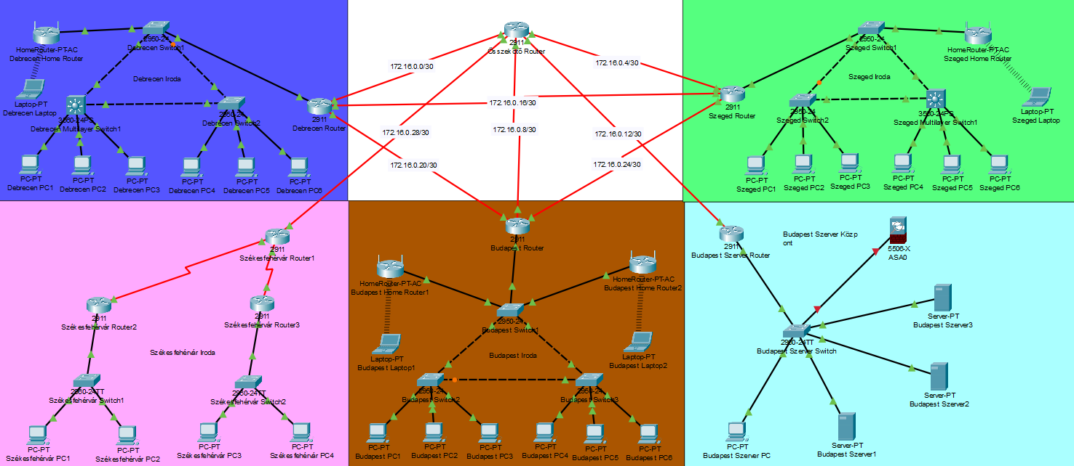
Full Network Layout

Slide 5
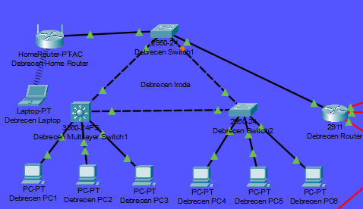
Debrecen Site
IPv4
VLAN10,20
DHCP

Slide 6
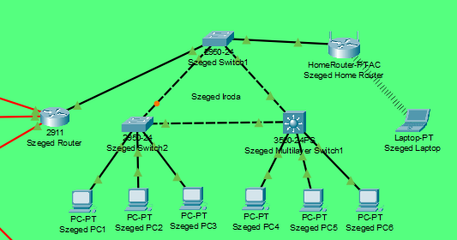
Szeged Site
IPv4
VLAN30,40
DHCP

Slide 7
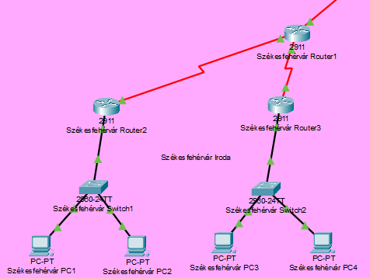
Székesfehérvár Site
IPv4
Dynamic Network Address Translation (NAT)
WAN Connection
ACL

Slide 8
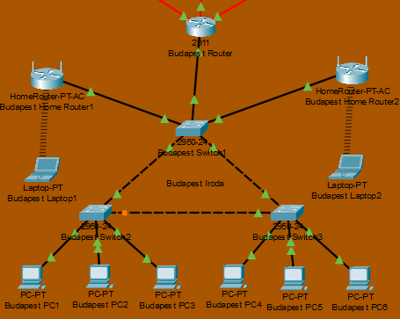
Budapest Site
IPv6
Switch stacking

Slide 9
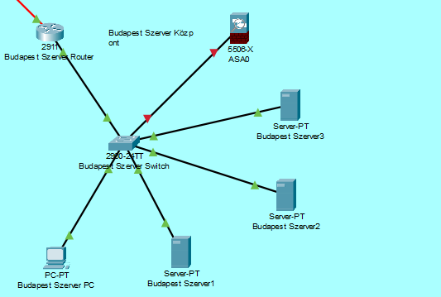
Budapest Server Center
IPv6
Firewall
Static Network Address Translation (NAT)
ACL

Slide 10



Jira & GitHUB & Scrum
Transparent workflow
Cloud based version control
Scrum provides the framework
Assignees and deadlines
Branching
Work in 1-4 week cycles (sprints)
Bug tracking
Daily progress discussions, followed by final evaluation

Slide 11
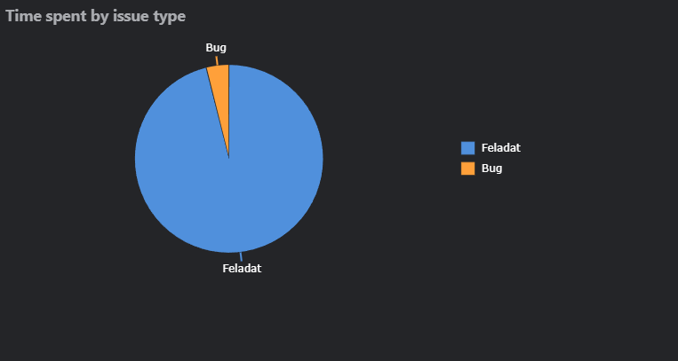
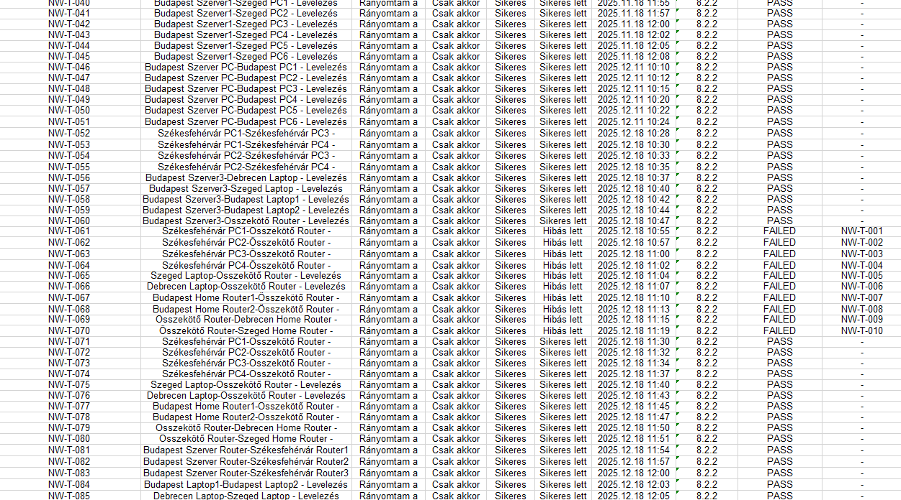
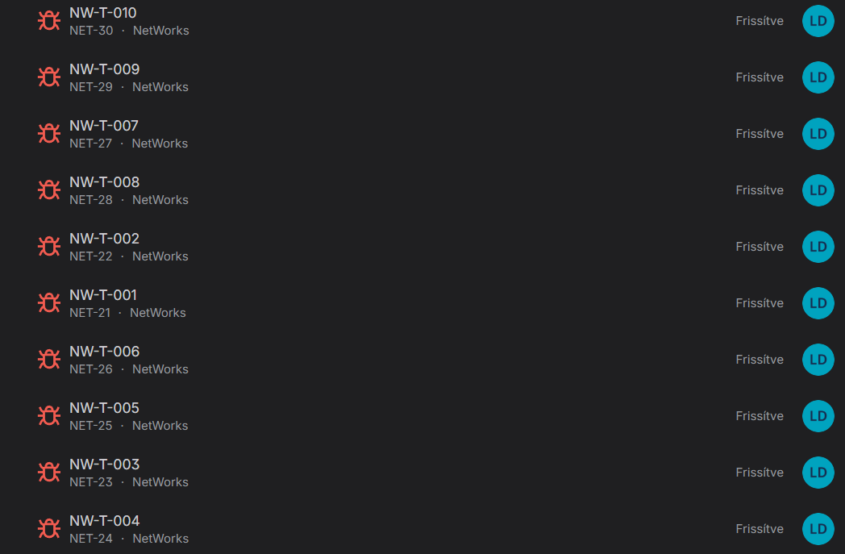
Testing & BUGs

Slide 12
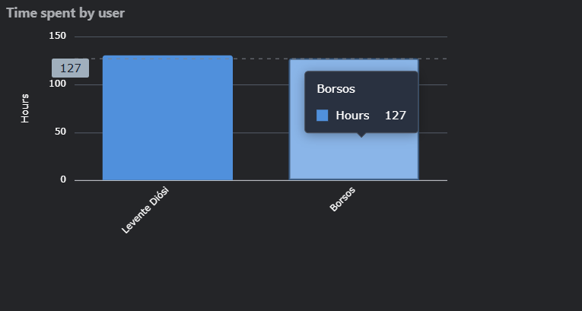
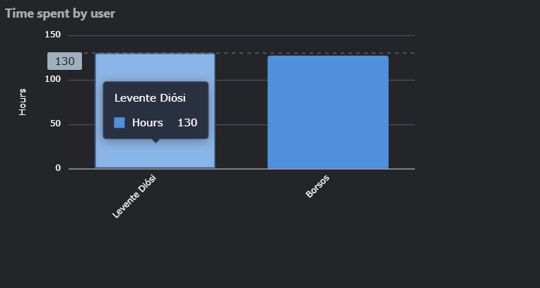
Logged Hours

Slide 13

Thank you for your attention!

